Slide 2
Overview
Part 1 – Registers, Microoperations and Implementations
Part 2 – Counters, register cells, buses, & serial operations
  Microoperations on single register (continued)
    Counters
  Register cell design
  Multiplexer and bus-based transfers for multiple registers
  Serial transfers and microoperations
Part 3 – Control of Register Transfers

Slide 3
Counters
Counters are sequential circuits which "count" through a specific state sequence. They can count up, count down, or count through other fixed sequences. Two distinct types are in common usage:
Ripple Counters
  Clock connected to the flip-flop clock input on the LSB bit flip-flop
  For all other bits, a flip-flop output is connected to the clock input, thus circuit is not truly synchronous!
  Output change is delayed more for each bit toward the MSB.
  Resurgent because of low power consumption
Synchronous Counters
  Clock is directly connected to the flip-flop clock inputs
  Logic is used to implement the desired state sequencing

Slide 4
Ripple Counter
How does it work?
  When there is a positive
  edge on the clock input
  of A, A complements
  The clock input for flip-
  flop B is the complemented
  output of flip-flop A
  When flip A changes
  from 1 to 0, there is a
  positive edge on the
  clock input of B
  causing B to
  complement
D
A
Clock
C_{R}
D
B
C_{R}
Reset
CP
A
B
0
1
2
3
0
1

Slide 5
Ripple Counter (continued)
The arrows show the
cause-effect relation-
ship from the prior
slide =>
The corresponding
sequence of states =>
(B,A) = (0,0),
Each additional bit, C, D, …behaves like bit B, changing half as frequently as the bit before it.
For 3 bits: (C,B,A) = (0,0,0), (0,0,1), (0,1,0), (0,1,1),
(1,0,0), (1,0,1), (1,1,0), (1,1,1), (0,0,0), …
CP
A
B
0
1
2
3
0
1
(0,1),
(1,0),
(1,1),
(0,0),
(0,1), …

Slide 6
Ripple Counter (continued)
These circuits are called ripple counters because each edge sensitive transition (positive in the example) causes a change in the next flip-flop’s state.
The changes “ripple” upward through the chain of flip-flops, i. e., each transition occurs after a clock-to-output delay from the stage before.
To see this effect in detail look at the waveforms on the next slide.

Slide 7
Ripple Counter (continued)
Starting with C = B = A = 1, equivalent to (C,B,A) = 7 base 10, the next clock increments the count to (C,B,A) = 0 base 10. In fine timing detail:
  The clock to output delay
  t_{PHL} causes an increasing
  delay from clock edge for
  each stage transition.
  Thus, the count “ripples”
  from least to most
  significant bit.
  For n bits, total worst case
  delay is n t_{PHL}.
t_{PHL}
CP
t_{PHL}
A
t_{pHL}
B
C

Slide 8
Synchronous Counters
To eliminate the "ripple" effects, use a common clock for each flip-flop and a combinational circuit to generate the next state.
For an up-counter,
use an incrementer =>
Incre-menter
A3
S3
D3
Q3
A2
S2
D2
Q2
A1
S1
D1
Q1
A0
S0
D0
Q0
Clock

Slide 9
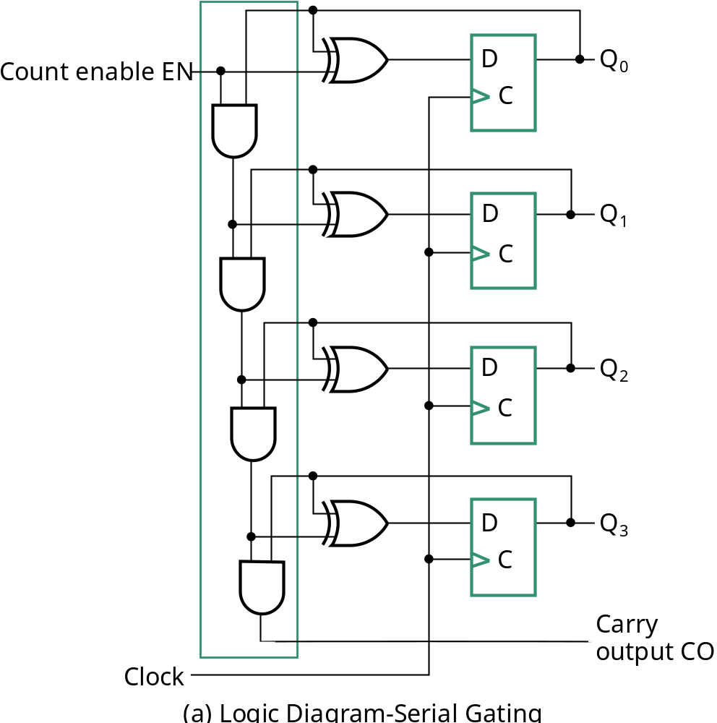
Synchronous Counters (continued)
Internal details =>
Internal Logic
  XOR complements each bit
  AND chain causes complement
  of a bit if all bits toward LSB
  from it equal 1
Count Enable
  Forces all outputs of AND
  chain to 0 to “hold” the state
Carry Out
  Added as part of incrementer
  Connect to Count Enable of
  additional 4-bit counters to
  form larger counters
Incrementer

Slide 10
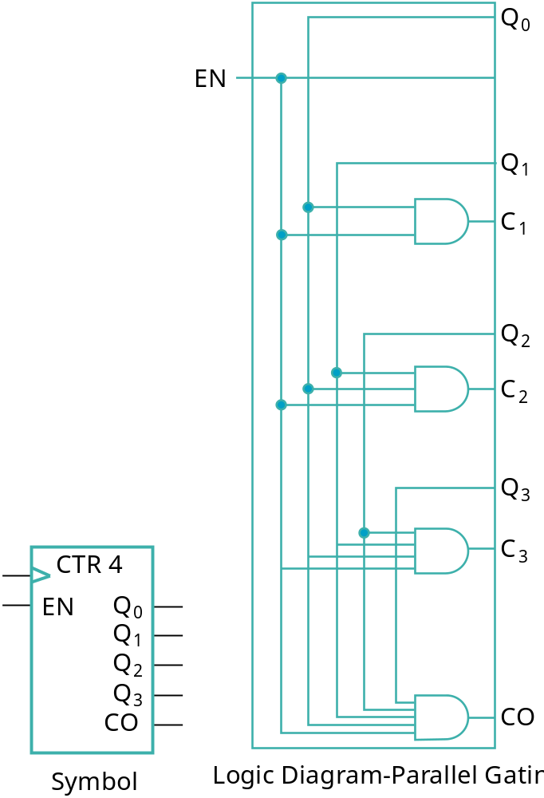
Synchronous Counters (continued)
Carry chain
  series of AND gates through which the
  carry “ripples”
  Yields long path delays
  Called serial gating
Replace AND carry chain with ANDs =>
in parallel
  Reduces path delays
  Called parallel gating
  Like carry lookahead
  Lookahead can be used on COs
  and ENs to prevent long paths in
  large counters
Symbol for Synchronous Counter

Slide 11
Other Counters
See text for:
  Down Counter - counts downward instead of upward
  Up-Down Counter - counts up or down depending on value a control input such as Up/Down
  Parallel Load Counter - Has parallel load of values available depending on control input such as Load
Divide-by-n (Modulo n) Counter
  Count is remainder of division by n; n may not be a power of 2 or
  Count is arbitrary sequence of n states specifically designed state-by-state
  Includes modulo 10 which is the BCD counter

Slide 12
Counter with Parallel Load
Add path for input data
  enabled for Load = 1
Add logic to:
  disable count logic for Load = 1
  disable feedback from outputs
  for Load = 1
  enable count logic for Load = 0
  and Count = 1
The resulting function table:
Load
Count
D
0
D
Q
0
C
D
1
D
Q
1
C
D
2
D
Q
2
Load | Count | Action
0 | 0 | Hold Stored Value
0 | 1 | Count Up Stored Value
1 | X | Load D
C
D
3
D
Q
3
C
Carry
Clock
Output CO

Slide 13
Design Example: Synchronous BCD
Use the sequential logic model to design a synchronous BCD counter with D flip-flops
State Table =>
Input combinations
1010 through 1111
are don’t cares
Current State
Next State
Q8 Q4 Q2 Q1
Q8 Q4 Q2 Q1
0 0 0 0
0 0 0 1
0 0 0 1
0 0 1 0
0 0 1 0
0 0 1 1
0 0 1 1
0
1 0 0
0 1 0 0
0 1 0 1
0 1 0 1
0 1 1 0
0 1 1 0
0 1 1 1
0 1 1 1
1 0 0 0
1 0 0 0
1 0 0 1
1 0 0 1
0 0 0 0

Slide 14
Synchronous BCD (continued)
Use K-Maps to two-level optimize the next state equations and manipulate into forms containing XOR gates:
D1 = Q1
D2 = Q2 + Q1Q8
D4 = Q4 + Q1Q2
D8 = Q8 + (Q1Q8 + Q1Q2Q4)
The logic diagram can be draw from these equations
  An asynchronous or synchronous reset should be added
What happens if the counter is perturbed by a power disturbance or other interference and it enters a state other than 0000 through 1001?

Slide 15
Synchronous BCD (continued)
Find the actual values of the six next states for the don’t care combinations from the equations
Find the overall state diagram to assess behavior for the don’t care states (states in decimal)
0
Present State | Next State
Q8 Q4 Q2 Q1 | Q8 Q4 Q2 Q1
1 0 1 0 | 1 0 1 1
1 0 1 1 | 0 1 1 0
1 1 0 0 | 1 1 0 1
1 1 0 1 | 0 1 0 0
1 1 1 0 | 1 1 1 1
1 1 1 1 | 0 0 1 0
9
1
14
8
2
15
12
7
11
13
3
6
10
4
5

Slide 16
Synchronous BCD (continued)
For the BCD counter design, if an invalid state is entered, return to a valid state occurs within two clock cycles
Is this adequate? If not:
  Is a signal needed that indicates that an invalid state has been entered? What is the equation for such a signal?
  Does the design need to be modified to return from an invalid state to a valid state in one clock cycle?
  Does the design need to be modified to return from a invalid state to a specific state (such as 0)?
The action to be taken depends on:
  the application of the circuit
  design group policy
See pages 244 of the text.
Notes:
Error = Q8 Q4 + Q8 Q2

Slide 17
Counting Modulo N
The following techniques use an n-bit binary counter with asynchronous or synchronous clear and/or parallel load:
  Detect a terminal count of N in a Modulo-N count sequence to asynchronously Clear the count to 0 or asynchronously Load in value 0 (These lead to counts which are present for only a very short time and can fail to work for some timing conditions!)
  Detect a terminal count of N - 1 in a Modulo-N count sequence to Clear the count synchronously to 0
  Detect a terminal count of N - 1 in a Modulo-N count sequence to synchronously Load in value 0
  Detect a terminal count and use Load to preset a count of the terminal count value minus (N - 1)
Alternatively, custom design a modulo N counter as done for BCD

Slide 18
Counting Modulo 7: Detect 7 and Asynchronously Clear
A synchronous 4-bit binary counter
with an asynchronous Clear is
used to make a Modulo
7 counter.
Use the Clear feature to
detect the count 7 and
clear the count to 0. This
gives a count of 0, 1, 2, 3, 4,
5, 6, 7(short)0, 1, 2, 3, 4, 5,
6, 7(short)0, etc.
DON’T DO THIS! Existence of state 7 may not be long enough to reliably reset all flip-flops to 0. Referred to as a “suicide” counter! (Count “7” is “killed,” but the designer’s job may be dead as well!)
D3
Q3
D2
Q2
D1
Q1
D0
Q0
Clock
CP
0
LOAD
CLEAR

Slide 19
Counting Modulo 7: Synchronously Load on Terminal Count of 6
A synchronous 4-bit binary
counter with a synchronous
load and an asynchronous
clear is used to make a
Modulo 7 counter
Use the Load feature to
detect the count "6" and
load in "zero". This gives
a count of 0, 1, 2, 3, 4, 5, 6,
0, 1, 2, 3, 4, 5, 6, 0, ...
Using don’t cares for states
above 0110, detection of 6 can be done with Load = Q4 Q2
0
D3
Q3
0
D2
Q2
0
D1
Q1
0
D0
Q0
Clock
CP
LOAD
Reset
CLEAR

Slide 20
Counting Modulo 6: Synchronously Preset 9 on Reset and Load 9 on Terminal Count 14
A synchronous, 4-bit binary
counter with a synchronous
Load is to be used to make a
Modulo 6 counter.
Use the Load feature to
preset the count to 9 on
Reset and detection of
count 14.
This gives a count of 9, 10, 11, 12, 13, 14, 9, 10, 11, 12, 13, 14, 9, …
If the terminal count is 15 detection is usually built in as Carry Out (CO)
1
D3
Q3
0
D2
Q2
0
D1
Q1
1
D0
Q0
Clock
CP
Reset
LOAD
1
CLEAR

Slide 21
Register Cell Design
Assume that a register consists of identical cells
Then register design can be approached as follows:
  Design representative cell for the register
  Connect copies of the cell together to form the register
  Applying appropriate “boundary conditions” to cells that need to be different and contract if appropriate
Register cell design is the first step of the above process

Slide 22
Register Cell Specifications
A register
Data inputs to the register
Control input combinations to the register
  Example 1: Not encoded
    Control inputs: Load, Shift, Add
    At most, one of Load, Shift, Add is 1 for any clock cycle
    (0,0,0), (1,0,0), (0,1,0), (0,0,1)
  Example 2: Encoded
    Control inputs: S1, S0
    All possible binary combinations on S1, S0
    (0,0), (0,1), (1,0), (1,1)

Slide 23
Register Cell Specifications
A set of register functions (typically specified as register transfers)
  Example:
  Load: A ← B
  Shift: A ← sr B
  Add: A ← A + B
A hold state specification
  Example:
    Control inputs: Load, Shift, Add
    If all control inputs are 0, hold the current register state

Slide 24
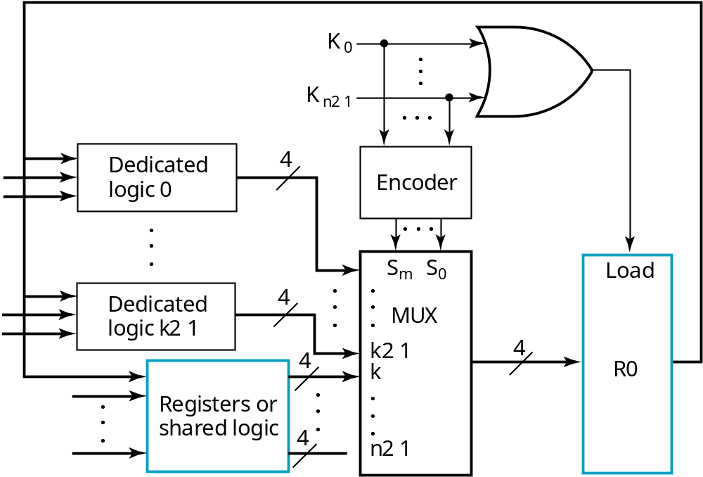
Multiplexer Approach
Uses an n-input multiplexer with a variety of transfer sources and functions

Slide 25
Multiplexer Approach
Load enable by OR of control signals K₀, K₁, … K_{n-1}
- assumes no load for 00…0
Use:
  Encoder + Multiplexer (shown) or
  n x 2 AND-OR
to select sources and/or
transfer functions

Slide 26
Example 1: Register Cell Design
Register A (m-bits) Specification:
  Data input: B
  Control inputs (CX, CY)
  Control input combinations (0,0), (0,1) (1,0)
  Register transfers:
  CX: A ← B v A
  CY :A ← B + A
  Hold state: (0,0)

Slide 27
Example 1: Register Cell Design (continued)
Load Control
Load = CX + CY
Since all control combinations appear as if encoded (0,0), (0,1), (1,0) can use multiplexer without encoder:
S1 = CX
S0 = CY
D0 = A_{i} Hold A
D1 = A_{i} ← B_{i} + A_{i} CY = 1
D2 = A_{i} ← B_{i} v A_{i} CX = 1
Note that the decoder part of the 3-input multiplexer can be shared between bits if desired

Slide 28
Sequential Circuit Design Approach
Find a state diagram or state table
  Note that there are only two states with the state assignment equal to the register cell output value
Use the design procedure in Chapter 5 to complete the cell design
For optimization:
  Use K-maps for up to 4 to 6 variables
  Otherwise, use computer-aided or manual optimization

Slide 29
Example 1 Again
State Table:
  Four variables give a total of 16 state table entries
  By using:
    Combinations of variable names and values
    Don’t care conditions (for CX = CY = 1)
  only 8 entries are required to represent the 16 entries
 | Hold | Ai v Bi |  | Ai + Bi
A_{i} | CX = 0 CY = 0 | CX = 1 B_{i} = 0 | CX = 1 B_{i} = 1 | CY = 1 B_{i} = 0 | CY = 1 B_{i} = 1
0 | 0 | 0 | 1 | 0 | 1
1 | 1 | 1 | 1 | 1 | 0

Slide 30
Example 1 Again (continued)
K-map - Use variable ordering CX, CY, A_{i} B_{i} and assume a D flip-flop
D_{i}
A_{i}
0
0
1
1
0
1
0
1
CY
X
X
X
X
CX
0
1
1
1
B_{i}

Slide 31
Example 1 Again (continued)
The resulting SOP equation:
D_{i} = CX B_{i} + CY A_{i} B_{i} + A_{i} B_{i} + CY A_{i}
Using factoring and DeMorgan’s law:
D_{i} = CX B_{i} + A_{i} (CY B_{i}) + A_{i}(CY B_{i} )
D_{i} = CX B_{i} + A_{i} + (CY B_{i})
The gate input cost per cell = 2 + 8 + 2 + 2 = 14
The gate input cost per cell for the previous version is:
Per cell: 19
Shared decoder logic: 8
Cost gain by sequential design > 5 per cell
Also, no Enable on the flip-flop makes it cost less

Slide 32
Multiplexer and Bus-Based Transfers for Multiple Registers
Multiplexer dedicated to each register
Shared transfer paths for registers
  A shared transfer object is a called a bus (Plural: buses)
Bus implementation using:
  multiplexers
  three-state nodes and drivers
In most cases, the number of bits is the length of the receiving register

Slide 33
Dedicated MUX-Based Transfers
Multiplexer connected to each register input produces a very flexible transfer structure =>
Characterize the simultaneous transfers possible with this structure.
S0
L0
n
S
n
Load
0
n
1
MUX
R0
S1
L1
n
S
n
Load
0
n
1
MUX
R1
S2
L2
n
S
n
Load
0
n
1
MUX
R2
Notes:
There can be three distinct registers as source, so can simultaneously do any three register transfers
- totally flexible.

Slide 34
Multiplexer Bus
A single bus driven by a multiplexer lowers cost, but limits the available transfers =>
Characterize the simultaneous transfers possible with this structure.
Characterize the cost savings compared to
dedicated multiplexers
L0
n
Load
R0
S1
S0
L1
n
S1 S0
0
Load
n
1
n
n
n
2
MUX
R1
L2
n
Load
R2
Notes:
Can have only one register as a source at a time. Thus a set of simultaneous transfers
can have only one register source. Could require up to three clock cycles if three different sources needed.
Costs:
Dedicated 18 gate inputs per bit plus 3 shared inverters with total of 3 inputs
Bus: 9 gate inputs per bit + shared decoder with 8 inputs
Bus clearly less costly.

Slide 35
Three-State Bus
The 3-input MUX can be replaced by a 3-state node (bus) and 3-state buffers.
Cost is further reduced, but transfers are limited
Characterize the simultaneous transfers possible with this structure.
Characterize the cost savings and compare
Other advantages?
L0
n
Load
n
R0
E0
L1
n
Load
n
R1
E1
L2
n
Load
n
R2
E2
Notes:
Same simultaneous transfer capability as multiplexer bus
Cost: 3 gate inputs per three state driver = 9 gate inputs
If decoder desired, 8 shared gate inputs.
Clearly least costly.
The “bus” is unique in that it is “bidirectional.” This is a significant advantage
since it cuts connections between chips for bus paths to 1/2.

Slide 36
Serial Transfers and Microoperations
Serial Transfers
  Used for “narrow” transfer paths
  Example 1: Telephone or cable line
    Parallel-to-Serial conversion at source
    Serial-to-Parallel conversion at destination
  Example 2: Initialization and Capture of the contents of many flip-flops for test purposes
    Add shift function to all flip-flops and form large shift register
    Use shifting for simultaneous Initialization and Capture operations
Serial microoperations
  Example 1: Addition
  Example 2: Error-Correction for CDs

Slide 37
Serial Microoperations
By using two shift registers for operands, a full adder, and a flip flop (for the carry), we can add two numbers serially, starting at the least significant bit.
Serial addition is a low cost way to add large numbers of operands, since a “tree” of full adder cells can be made to any depth, and each new level doubles the number of operands.
Other operations can be performed serially as well, such as parity generation/checking or more complex error-check codes.
Shifting a binary number left is equivalent to multiplying by 2.
Shifting a binary number right is equivalent to dividing by 2.

Slide 38
Serial Adder
Load/Right Shift Registers
The circuit shown uses two shift
registers for operands A(3:0)
and B(3:0).
A full adder, and one more
flip flop (for the carry) is used
to compute the sum.
The result is stored in the
A register and the final
carry in the flip-flop
With the operands and the
result in shift registers, a tree of full adders can be
used to add a large number of operands. Used as a common digital signal processing technique.
Serial
In
A
FA
A3 A2 A1 A0
B
Sum
Parallel Load
Cin
Serial
Cout
In
B3 B2 B1 B0
Parallel Load
Q
D
(Clock and Load/Shift
CP
Control not shown)

Slide 39
Terms of Use
All (or portions) of this material © 2008 by Pearson Education, Inc.
Permission is given to incorporate this material or adaptations thereof into classroom presentations and handouts to instructors in courses adopting the latest edition of Logic and Computer Design Fundamentals as the course textbook.
These materials or adaptations thereof are not to be sold or otherwise offered for consideration.
This Terms of Use slide or page is to be included within the original materials or any adaptations thereof.

